Slide 1


Healthcare Data Analysis and Visualization for Disease Trend Monitoring Using R
Presented by: Guided by:
Mohammed Aish Ahamed Siddiqui (192424320) DR. KUMARAGURUBARAN T
S. Asif (192424121) DR. SENTHILVADIVU SUBRAMANIAN
S. M. Junaid (192424142)

Slide 2
ABSTRACT
This project focuses on analyzing healthcare data to monitor disease trends using R programming. Healthcare datasets are collected, cleaned, and preprocessed to ensure accuracy and reliability. Exploratory data analysis is carried out to identify patterns and variations in disease occurrence over time. Various data visualization techniques, including bar charts and line graphs, are used to clearly represent disease trends. The visual insights obtained from the analysis help in understanding disease spread and support effective healthcare planning and decision-making.

Slide 3
INTRODUCTION
Healthcare systems generate large volumes of patient and disease-related data.
Most healthcare data is raw and unstructured, making analysis difficult.
Disease trend monitoring helps understand disease spread, frequency, and seasonal patterns.
Traditional analysis methods are inefficient for large healthcare datasets.
This project uses data analytics and visualization to transform healthcare data into meaningful insights.
R programming is used to analyze and visualize disease trends for better healthcare decision-making.

Slide 4
PROBLEM STATEMENT
Healthcare data is generated in large volumes but is often unstructured and inconsistent.
Raw healthcare data requires proper cleaning and preparation before analysis.
Traditional methods are inefficient for analyzing disease trends over time.
Identifying seasonal and long-term disease patterns is challenging.
Comparing disease distribution across regions is difficult without visualization.
An integrated modular system is needed to convert healthcare data into meaningful insights for decision-making.

Slide 5
OBJECTIVES
To collect and prepare healthcare data for accurate analysis and visualization.
To clean and preprocess raw healthcare datasets to improve data quality.
To analyze disease trends and temporal patterns over time.
To identify seasonal and long-term variations in disease occurrence.
To visualize disease distribution and regional patterns effectively.
To generate meaningful insights that support data-driven healthcare decision-making.

Slide 6
METHODOLOGY
Overview
  The project follows a structured, modular methodology to analyze healthcare data and monitor disease trends. It integrates data preparation, exploratory and trend analysis, and advanced visualization to generate meaningful healthcare insights.
Overall Workflow
  Data Collection & Preparation
  Exploratory Data Analysis & Trend Detection
  Advanced Visualization & Insight Communication
Dataset Details
  Type: Healthcare Dataset (Synthetic, Realistic)
  Records: 50,000
  Format: CSV (Comma-Separated Values)
  Data Level: Patient admission level
  Time Span: Multi-year
  Regions Covered: Multiple regions
Key Dataset Attributes
  Demographic: Age, Gender, Blood Type
  Medical: Medical Condition, Severity, Outcome
  Time-based: Date of Admission, Month, Year
  Location: Region, Latitude, Longitude
  Financial: Billing Amount, Insurance

Slide 7
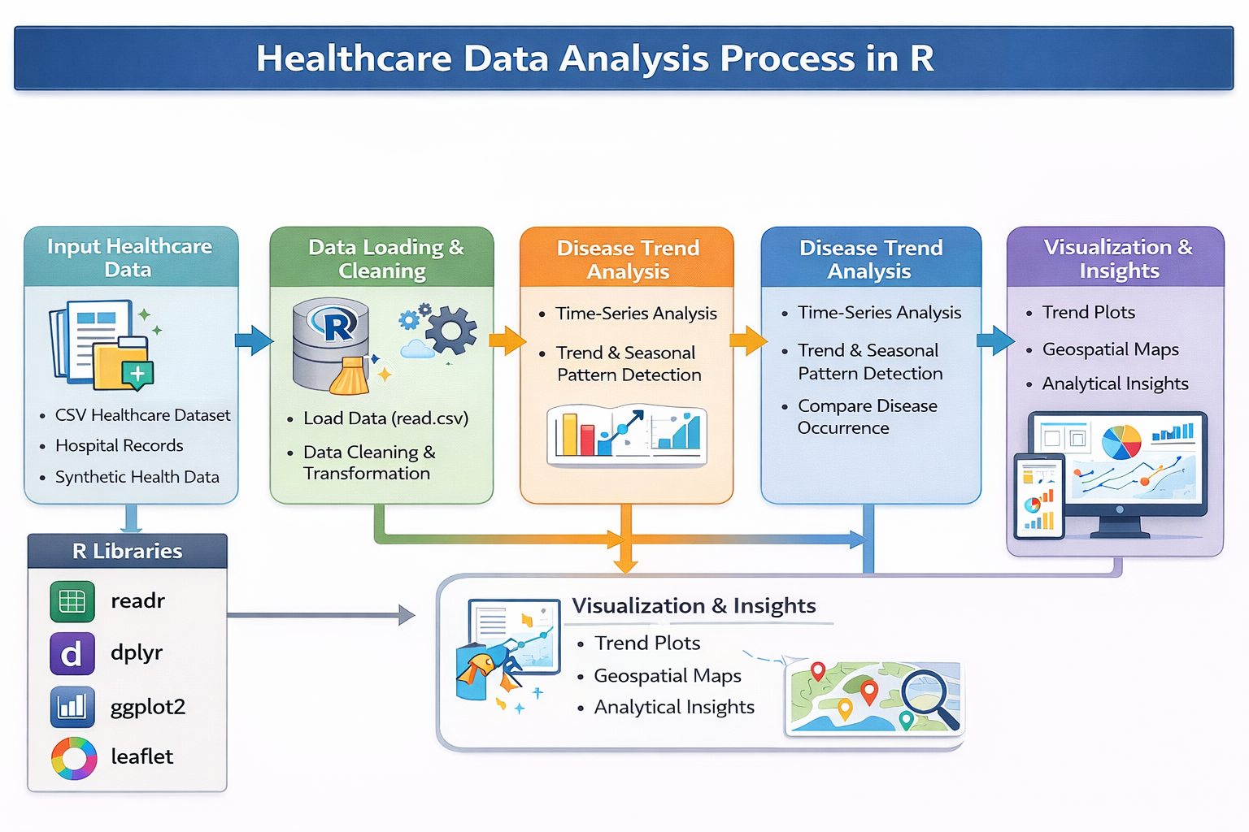
ARCHITECTURE DIAGRAM

Slide 8
MODULES
Module 1: Healthcare Data Collection, Cleaning, and Geospatial Preparation
Module 2: Disease Trend Analysis and Temporal Patterns
Module 3: Disease Distribution, Comparative Analysis, and Insights

Slide 9
Module 1: Healthcare Data Collection, Cleaning
Purpose:
Prepare healthcare data for analysis and spatial insights
Key Activities:
  Collect disease-related datasets with regional information
  Clean missing, inconsistent, and duplicate data
  Format attributes such as date, disease type, cases, and location
  Integrate geographic fields (region, district, latitude/longitude)
Techniques Used:
  Data cleaning and preprocessing in R
  Basic geospatial data handling and mapping in R
Output:
  Clean, structured, and geospatially enabled healthcare dataset

Slide 10
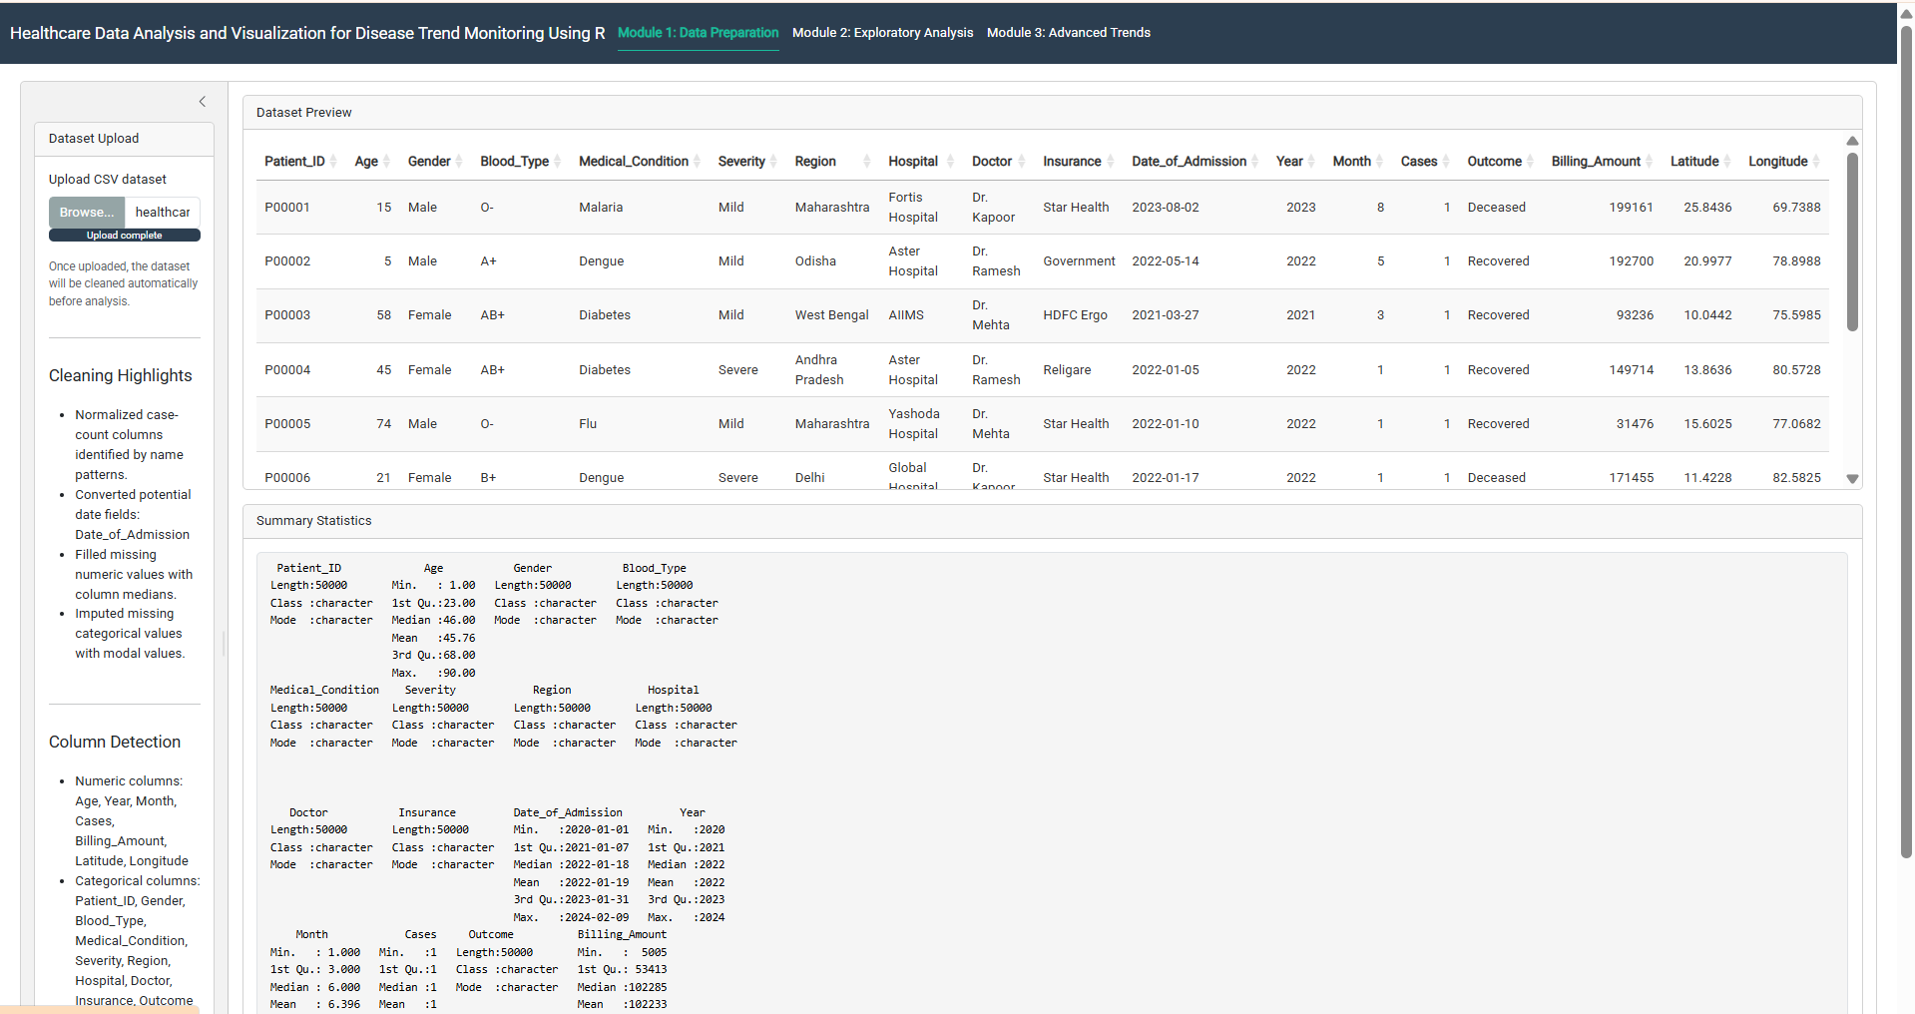
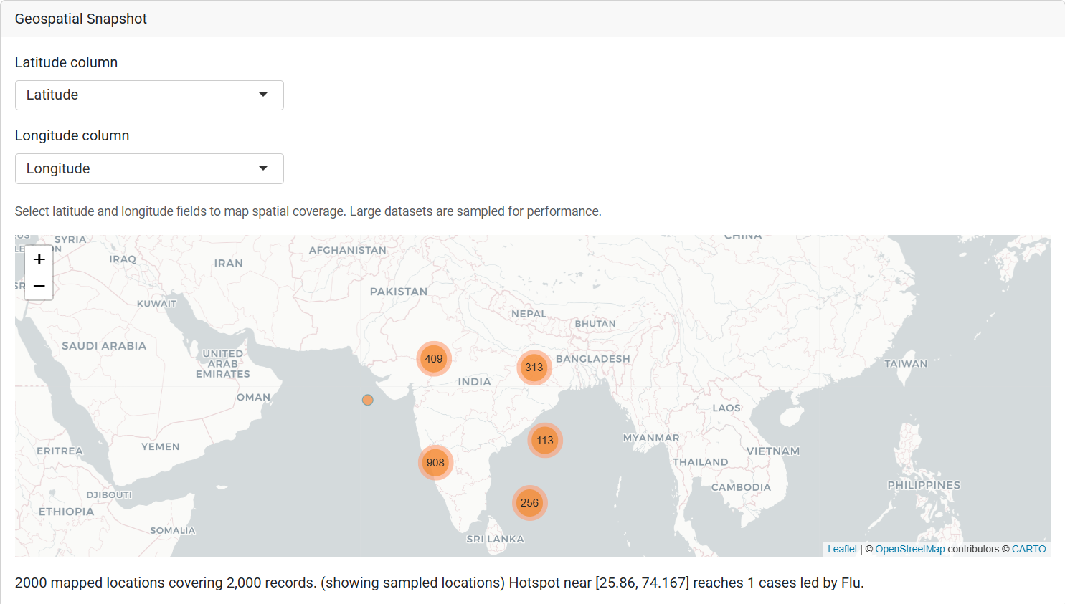
OUTPUT

Slide 11
Module 2: Disease Trend Analysis and Temporal Patterns
Purpose:
Understand disease distribution, comparisons, and trends over time
Key Activities:
  Analyze disease cases across different categories
  Compare disease counts by gender, age group, and region
  Examine trends in disease occurrence over time
Visualizations Used:
  Bar plots, histograms, boxplots, pie charts
  Line charts for trend analysis
Output:
  Insights on disease distribution, proportions, and trends

Slide 12
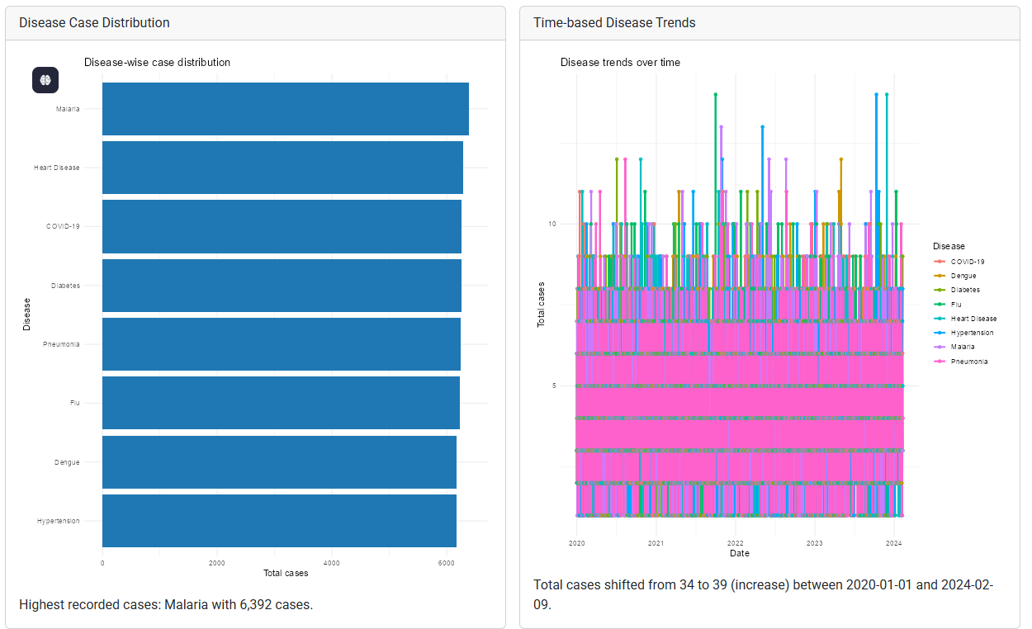
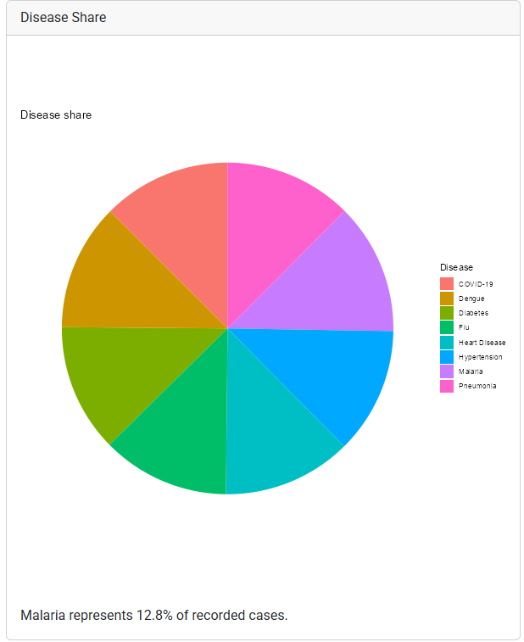
OUTPUT

Slide 13
Module 3: Disease Distribution, Comparative Analysis, and Insights
Purpose:
Monitor disease trends over time and understand distribution patterns
Key Activities:
  Analyze increase or decrease in disease cases over time
  Compare multiple diseases across different time periods
  Study disease distribution to extract meaningful insights
Visualizations Used:
  Line plots and multi-line trend graphs
  Supporting distribution charts for insights
Output:
  Clear trend-based and distribution-based insights for decision-making

Slide 14
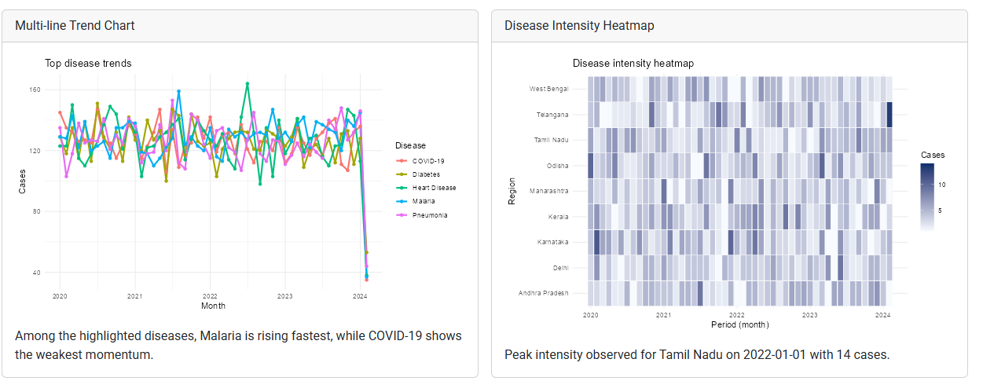
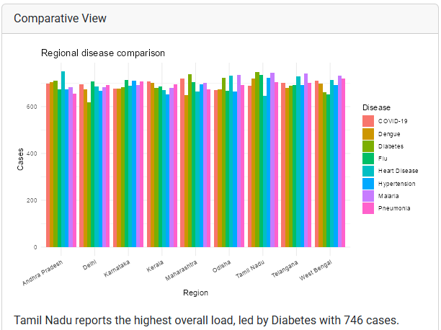
OUTPUT

Slide 15
Future Scope
Integration of real-time healthcare data for continuous monitoring
Predictive disease trend analysis using machine learning models
Advanced geospatial visualization to track regional disease spread
Interactive dashboards using R Shiny or Tableau
Integration with Electronic Health Records (EHR) systems
Decision support for healthcare authorities and policymakers

Slide 16
Results and Discussion
Healthcare data was cleaned and prepared using R for accurate analysis
EDA revealed disease patterns across time, age groups, and regions
Basic charts effectively displayed disease distribution and comparisons
Advanced visualizations showed seasonal effects and trend variations
Trend analysis identified high-risk periods and affected populations
Visual outputs simplified healthcare data for better understanding and decisions

Slide 17
CONCLUSION
The project demonstrated effective use of R for healthcare data analysis and visualization.
Proper data collection and preprocessing improved analysis accuracy.
Exploratory data analysis revealed key disease patterns and distributions.
Advanced visualizations highlighted disease trends and seasonal changes.
Results enabled early identification of high-risk periods and populations.
Overall, visualization proved to be a powerful tool for healthcare decision-making.

Slide 18
REFERENCES
Wickham, H., & Grolemund, G. (2017). R for Data Science: Import, Tidy, Transform, Visualize, and Model Data. O’Reilly Media.
Hadley Wickham (2016). ggplot2: Elegant Graphics for Data Analysis. Springer.
World Health Organization. (2023). Health Data and Disease Surveillance Reports.
Centers for Disease Control and Prevention. (2022). Public Health Data and Trend Analysis Documentation.
James, G., Witten, D., Hastie, T., & Tibshirani, R. (2021). An Introduction to Statistical Learning with Applications in R. Springer.
R Core Team. (2024). R: A Language and Environment for Statistical Computing.
Knaflic, S. N. (2020). Storytelling with Data: A Data Visualization Guide for Business Professionals. Wiley.

